Slide 1
ADDRESSING THE 5G REQUIREMENT FROM the CEPT PERSPECTIVE
CEPT ECC Chairman
Eric Fournier
EU Workshop on Spectrum Planning for 5G
Brussels, 13th November 2014

Slide 2
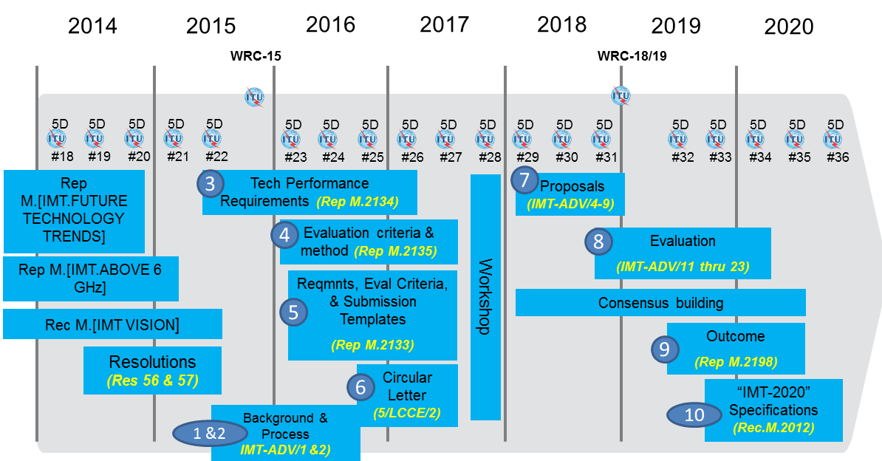
5G as IMT 2020 long process for standardization and spectrum harmonization

Slide 3
Addressing all the demands
5G features are already in today’s discussion
Wider bandwidth : 2.3, 2.6 and/or 3.6 GHz bands
M2M (700 MHz)
Small cells, femtocells
Cognitive technology and new sharing solutions (LSA)
Better adjacent band coexistence requirement
Securing WRC-19 agenda item on 5G
Inputs from industry justifying the spectrum need for 5G at WRC-19
Exact formulation yet to be discussed:
Limited to spectrum > 6 GHz ?
Or reviewing frequency bands already studied under WRC-15 AI 1.1 ?

Slide 4
The process for securing WRC-19 Agenda Item on 5G
ASMG
Industry
ATU
Administrations
APT
ECC/PT1
CITEL
CPG PTA develops an ECP on WRC-15 Agenda Item 10
RCC
CPG adopts ECP
WRC-15 2-27 Nov.15
CPM19-1 30 Nov – 1st Dec 15
4 years studies …
WRC-19

Slide 5
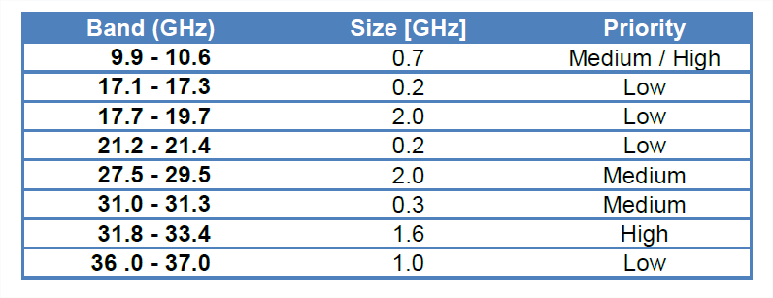
METIS : BANDS IDENTIFIED FROM 9 TO 40 GHz
Radars, Defence, PMSE, Fixed, BWA, radioastronomy
Defence, SRD, Ground radars
Earth Stations, ESOMP, Passive satellite, Fixed
PMSE
BFWA, earth stations, ESOMP, Fixed
Fixed, Radioastronomy
Fixed
Defence, passive satellite, radioastronomy

Slide 6
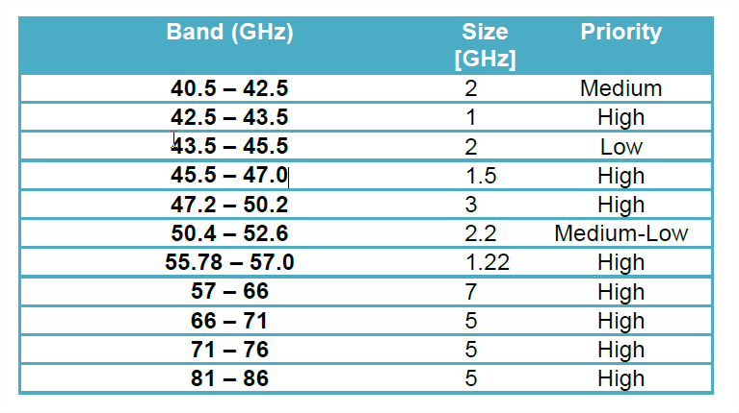
METIS : BANDS IDENTIFIED FROM 40 TO 86 GHz
Earth Stations, Fixed, MWS
Earth Stations, Fixed, MWS, radioastronomy
Defence, radionavigation, radionavigation satellite
Radionavigation radionavigation satellite
Earth stations, PMSE, HAPS, fixed
Fixed, radioastronomy, earth stations
Fixed, passive sensors
Fixed, SRD, Wideband data, Passive satellite, radars
Satellite services
Short and Long range radars, fixed
Fixed service, radioastronomy, Defence

Slide 7
MAIN CONCLUSIONS
Yes, 5G spectrum will be on WRC-19 Agenda
Incumbent have to be managed : sharing, migration … ?
Worldwide harmonisation requires the widest availability amongst ITU member states
Long road to study all issues for identification at WRC-19
European preparation for WRC-19 will be set up immediately after WRC-15
5G announced amongst the priority

Slide 8
THANKS !

